Slide 1
Module 5 Extended Query Formulation with SQL
Lesson 2: Multiple Table Problems
Notes:
Welcome to lesson 2 of Module 5 on extended query formulation with SQL
Query formulation is an important skill in application development.
Everyone involved in the application development must be competent in query formulation.
Most students will be involved (at least initially) in application development rather than in a role as a database specialist. Database specialists must also understand query formulation and SQL.
Opening question:
- Why are multiple table problems common in both transaction processing and data warehouse environments?

Slide 2
Lesson Objectives
Use the critical questions to analyze more complex problem statements
Write SELECT statements for more complex problems involving more than 2 tables
Notes:
Need lots of practice to improve query formulation skills
Use the critical questions explicitly at first, then implicitly

Slide 3
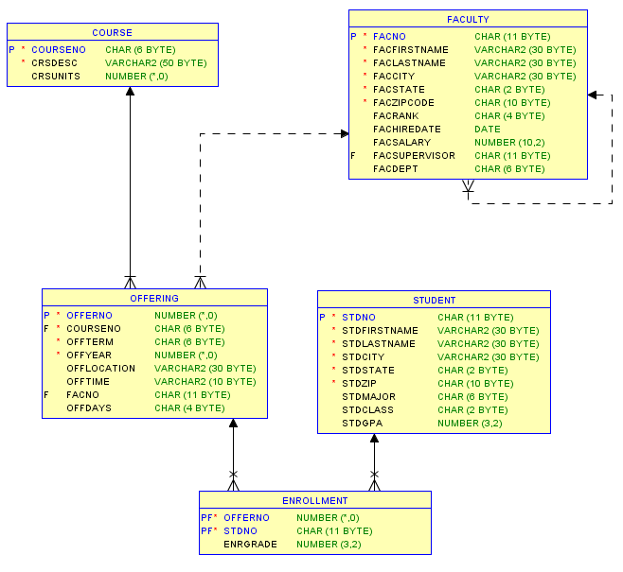
University Database Diagram
Notes:
Use database diagram to answer critical questions
The examples in the next slides involve the 3, 4, and 5 tables connected by relationships. Try to identify them in the problem statement.

Slide 4
Combining 3 Tables
Example 1: List Leonard Vince’s teaching schedule in fall 2012. For each course, list the offering number, course number, number of units, days, location, and time.
SELECT OfferNo, Offering.CourseNo, CrsUnits, OffDays,
OffLocation, OffTime
FROM Faculty, Course, Offering
WHERE Faculty.FacNo = Offering.FacNo
AND Offering.CourseNo = Course.CourseNo
AND OffYear = 2012 AND OffTerm = 'FALL'
AND FacFirstName = 'LEONARD'
AND FacLastName = 'VINCE';
Notes:
What tables?
Faculty: Leonard Vince is a faculty member
Offering: need offering days, location, and time
Course: need number of units; CourseNo can come from either Course or Offering
What connections among tables?
FacNo: PK (Faculty), FK (Offering)
CourseNo: PK (Course), FK (Offering)
Individual rows versus row summaries?
- No aggregate functions in the result nor tested in conditions

Slide 5
Combining 4 Tables
Example 2: List Bob Norbert’s course schedule in spring 2013. For each course, list the offering number, course number, days, location, time, and faculty name.
SELECT Offering.OfferNo, Offering.CourseNo, OffDays,
OffLocation, OffTime, FacFirstName,
FacLastName
FROM Faculty, Offering, Enrollment, Student
WHERE Offering.OfferNo = Enrollment.OfferNo
AND Student.StdNo = Enrollment.StdNo
AND Faculty.FacNo = Offering.FacNo
AND OffYear = 2013 AND OffTerm = 'SPRING'
AND StdFirstName = 'BOB'
AND StdLastName = 'NORBERT';
Notes:
What tables?
Student: Bob Norbert is a student.
Offering: need offering days, location, and time; conditions on offering year and term
Enrollment: need course schedule so Enrollment table connects Student and Offering
Faculty: need faculty name
Course table is not needed: CourseNo can come from Offering
What connections among tables?
FacNo: PK (Faculty), FK (Offering)
StdNo: PK (Student), FK (Enrollment)
OfferNo: PK (Offering), FK (Enrollment)
Individual rows versus row summaries?
- No aggregate functions in the result nor tested in conditions

Slide 6
Combining 5 Tables
Example 3: List Bob Norbert’s course schedule in spring 2013. For each course, list the offering number, course number, days, location, time, course units, and faculty name.
SELECT Offering.OfferNo, Offering.CourseNo, OffDays,
OffLocation, OffTime, CrsUnits, FacFirstName,
FacLastName
FROM Faculty, Offering, Enrollment, Student, Course
WHERE Faculty.FacNo = Offering.FacNo
AND Offering.OfferNo = Enrollment.OfferNo
AND Student.StdNo = Enrollment.StdNo
AND Offering.CourseNo = Course.CourseNo
AND OffYear = 2013 AND OffTerm = 'SPRING'
AND StdFirstName = 'BOB'
AND StdLastName = 'NORBERT';
Notes:
In video quiz after Example 3 requirements, before SELECT statement shown.
Small extension to example 2: need the course table for course units column
What tables?
Student: Bob Norbert is a student.
Offering: need offering days, location, and time; conditions on offering year and term
Enrollment: need course schedule so Enrollment table connects Student and Offering
Faculty: need faculty name
Course table is needed: CourseNo can come from Offering but course units from the course table
What connections among tables?
FacNo: PK (Faculty), FK (Offering)
StdNo: PK (Student), FK (Enrollment)
OfferNo: PK (Offering), FK (Enrollment)
CourseNo: PK (Course), FK (Offering)
Individual rows versus row summaries?
- No aggregate functions in the result nor tested in conditions

Slide 7
Summary
Have a mental image of the query formulation process
Use critical questions for converting a problem statement into a database representation
Use a database diagram for connections among tables
Notes:
Query formulation process
Transform problem statement into a database representation using the critical questions
Convert database representation into a SELECT statement using similar examples.
The critical questions and database diagrams are the most important problem solving aids.
Joins are common in both decision making for transaction processing and business intelligence because database designs typically have tens to hundreds of tables. Combining tables is necessary to answer questions about operational decision making and higher level decision making.

